Slide 1
Artificial Intelligence
(Machine Learning & Deep Learning)
{
Advanced OOP: Polymorphism, Abstraction, & Magic Methods
}
...

Slide 2
{
..
"The most dangerous phrase in the language is, 'We’ve always done it this way.'" – Grace Hopper
(Computer Science Pioneer & inventor of the first compiler)
}
..

Slide 3
Contents of Day 8
Conditional Execution & Loops
Recap & introduction | Review of Inheritance, Encapsulation (Private/Public), and Composition.
Core Thoery | • Polymorphism & Dynamic Polymorphism. • Operator Overloading & Magic (Dunder) Functions. • Abstract Classes, Data Classes, and Empty Classes. • Keyword Arguments (**kwargs)
Lab Practice | Practical coding tasks implementing method overriding, magic functions, and data classes.
Advance Lab | Building a strict AI pipeline template using Abstract Base Classes.
Wrap-up & Q&A | Debugging OOP logic, resolving MRO conflicts, and preparing for tomorrow's topic: Descriptive Statistics and Probability.
Important:
Use of AI for solving given task is not allowed.
Cellphones must be put on silent.

Slide 4
Today Objective - Flexibility & Strict Rules
Yesterday, we built the (Classes and Inheritance).Today, we are learning how to make our code both Flexible (Polymorphism) and Strict (Abstraction).
Why it matters in AI: When you build an AI pipeline, you want to be able to plug in 10 different types of models (Neural Networks, Decision Trees, etc.) without rewriting your main code. Polymorphism lets you treat them all exactly the same, while Abstraction forces your teammates to follow your architectural rules so they don't break the system.
}
..

Slide 5
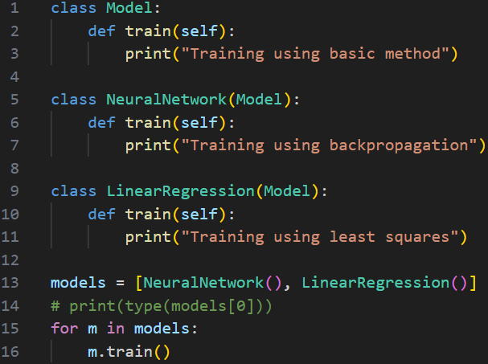
Core Concept (Definition & Rules)
Definition:
Polymorphism & Dynamic Polymorphism
Polymorphism
The ability of different objects to respond differently to the same method call.
Dynamic Polymorphism (Runtime Polymorphism)
When a child class overrides a method of the parent class, and the method executed is determined at runtime based on the object type.
AI Application:
Calling model.train() on a Neural Network vs. a Linear Regression model. They both execute "train", but the math they do inside is completely different.

Slide 6
Core Concept (Definition & Rules)
Definition:
Magic Functions (Dunder Functions)
Special predefined methods in Python that begin and end with double underscores (e.g., __init__, __str__, __add__). They are called internally by Python to perform built-in operations.
The Analogy: The "Under the Hood" wiring. When you type print(my_object), Python secretly goes under the hood and calls my_object.__str__(). They are called "Magic" because you usually don't call them directly; Python just magically runs them for you when you use standard symbols.

Slide 7
Core Concept (Definition & Rules)
Operator Overloading
Definition:
Giving extended, custom meaning beyond the predefined operational meaning to operators like +, -, *, or ==.
Example:
You already know what + does to numbers (5 + 5 = 10)
and strings ("A" + "B" = "AB").
Operator Overloading lets you teach Python what + means when you try to add two custom AI Dataset objects together. Should it merge the files? Should it crash? You get to decide!

Slide 8
Core Concept (Definition & Rules)
Definition:
Abstract Classes & Methods
An abstract class cannot be instantiated directly. It contains abstract methods (methods declared but containing no implementation logic). Any Subclass inheriting from it must provide the implementation for those methods.
AI Application:
Creating a base AIEngine class that forces every developer on your team to write a clean_data() method before they are allowed to train a model.

Slide 9
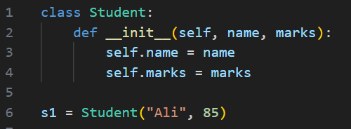
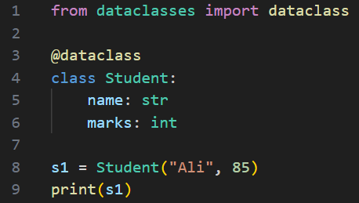
Core Concept (Definition & Rules)
Definition:
Data Class & Empty Class
Empty Class: A class with no attributes or methods, created using the pass keyword. Used as a placeholder for future implementation.
Data Class: A decorator (@dataclass) introduced in Python 3.7 designed strictly to hold state/data rather than complex logic, automatically generating __init__ for you.

Slide 10
Core Concept (Definition & Rules)
Definition:
Keyword Arguments (**kwargs)
Passing arguments to a function or class by explicitly stating the parameter name, allowing you to pass a variable number of named arguments wrapped into a dictionary.
**kwargs allows a function to accept a variable number of keyword arguments.
*args → collects extra positional arguments
**kwargs → collects extra keyword arguments Stored as a dictionary inside the function

Slide 11
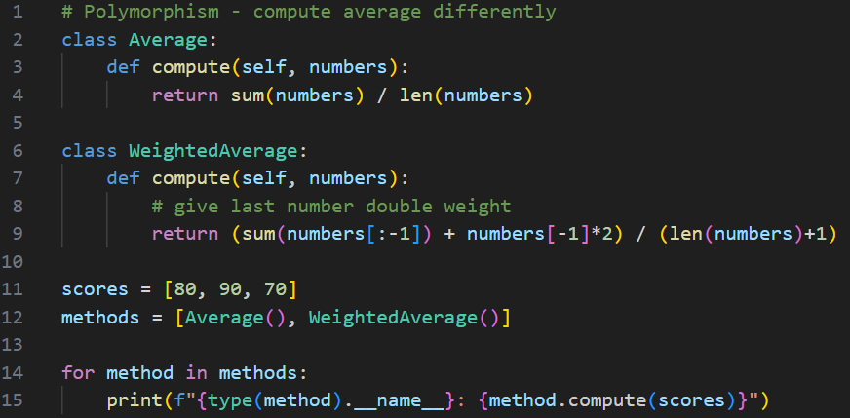
Practical exercise 01
Lab Task 1 – # Polymorphism - compute average differently
*

Slide 12
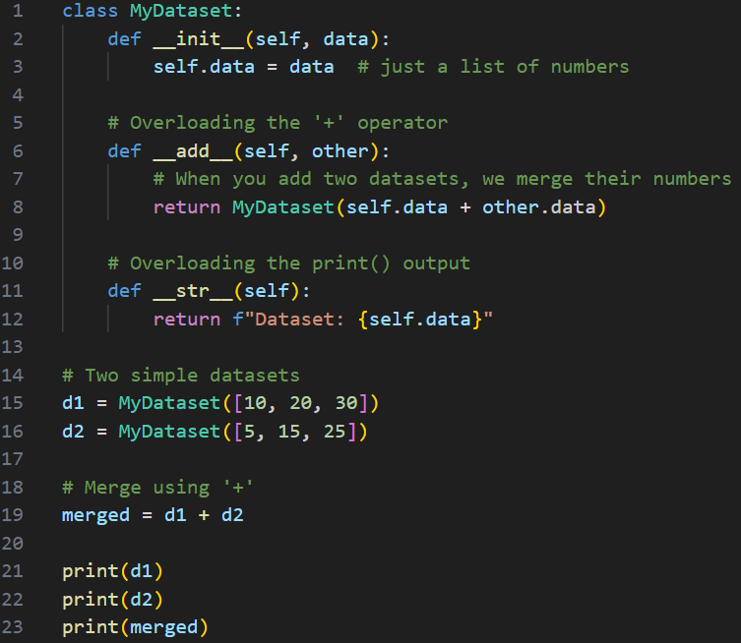
Practical exercise 02
Lab Task 2 – Magic Functions (Dunder Functions) Operator Overloading
*

Slide 13
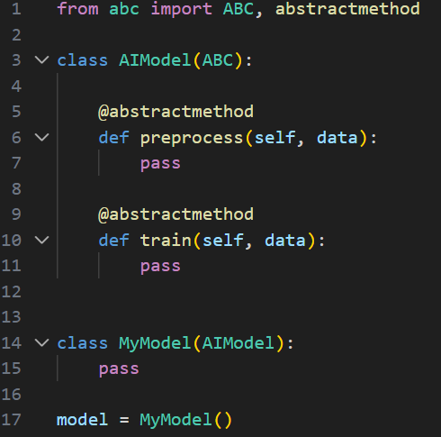
Practical exercise 03
Lab Task 3 – Abstract Method
*

Slide 14
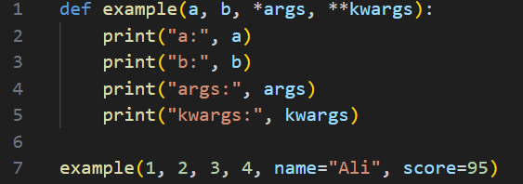
Practical exercise 04
Lab Task 4 – *args & **kargs
*

Slide 15
Thank You for Your Focus Today!
What was the most
confusing
part of today's lab?
Waleed Khan
(Robotics Engineer | Senior Python Developer)
Email: 0xcloudcoder@gmail.com
Contact: +923126008702
}
*

